Slide 1
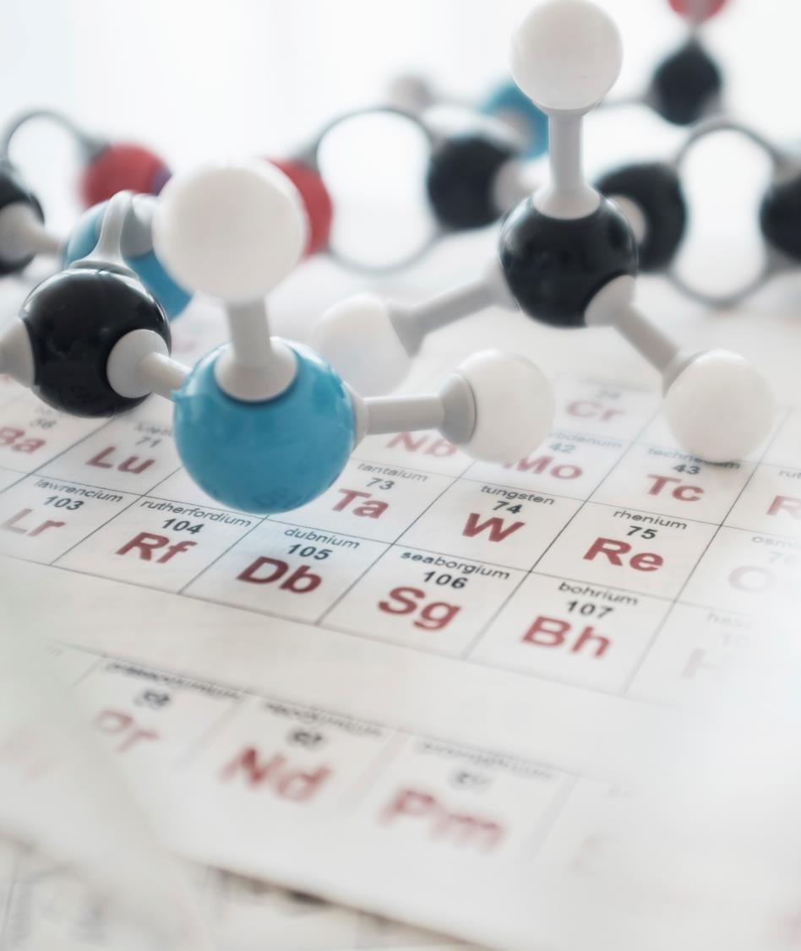
Cancer Risk Assessment Calculator
Kusuma Korada

Slide 2
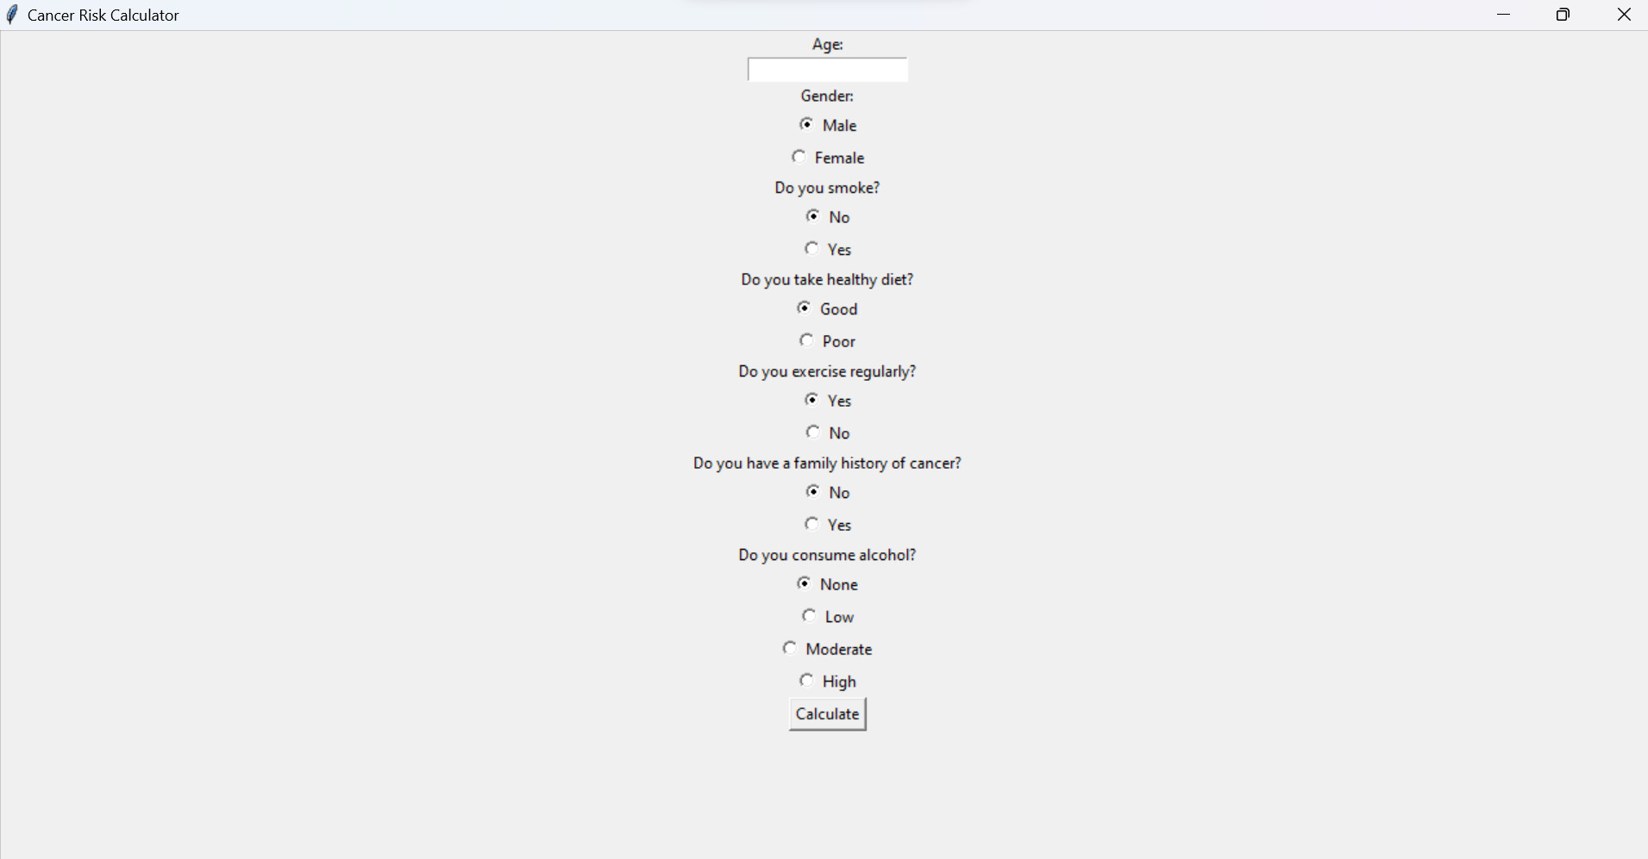
Project Overview: Cancer Risk Calculator
Plan: To develop a GUI-based Cancer Risk Calculator in Python that will help users to calculate their risk of developing cancer based on several factors, such as age, gender, smoking, diet, exercise, family history, and alcohol consumption.
Modules: GUI and Functions.
Dataflow/Major Functionalities: Users will use GUI to input their information on several factors, such as age, gender, smoking, diet, exercise, family history, and alcohol consumption. The entered data will be processed using the defined functions to calculate the risk level of developing cancer. The calculated risk level will be displayed on the GUI in a label.
Input: User’s information on age, gender, smoking, diet, exercise, family history, and alcohol consumption.
Output: Risk level of developing cancer

Slide 3

Major Applications
The Cancer Risk Assessment Calculator is designed to help individuals determine their risk of developing cancer. The calculator takes into account various factors such as age, gender, smoking habits, diet, exercise, family history, and alcohol consumption to determine the risk level of the individual.
This tool can be used by healthcare professionals to educate and counsel their patients on how to reduce their risk of developing cancer

Slide 4

Long Term Goals
The long-term goal of the Cancer Risk Assessment Calculator is to develop a comprehensive cancer risk assessment tool that incorporates genetic and environmental risk factors.
The tool can be integrated with Electronic Health Records (EHRs) and other health information systems to provide healthcare providers with accurate and up-to-date information on their patients’ cancer risk.
Additionally, the tool can be used in clinical research to identify high-risk individuals and develop personalized prevention and treatment plans

Slide 5
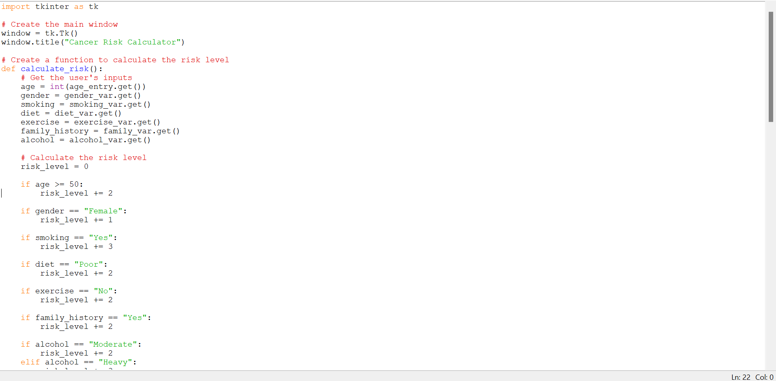
Python Code

Slide 6
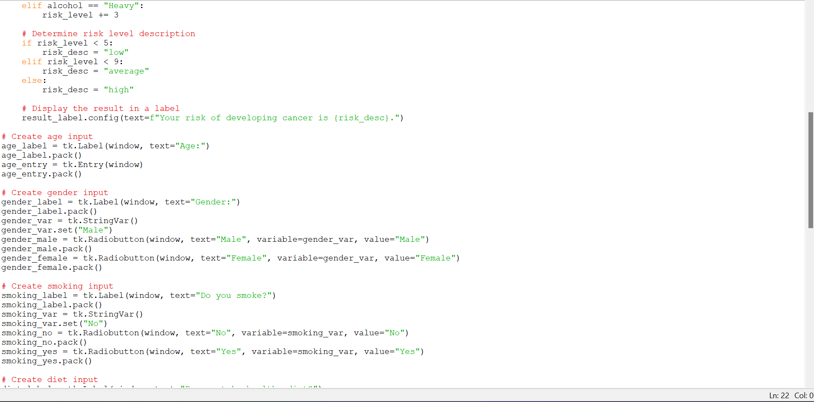
Python Code

Slide 7
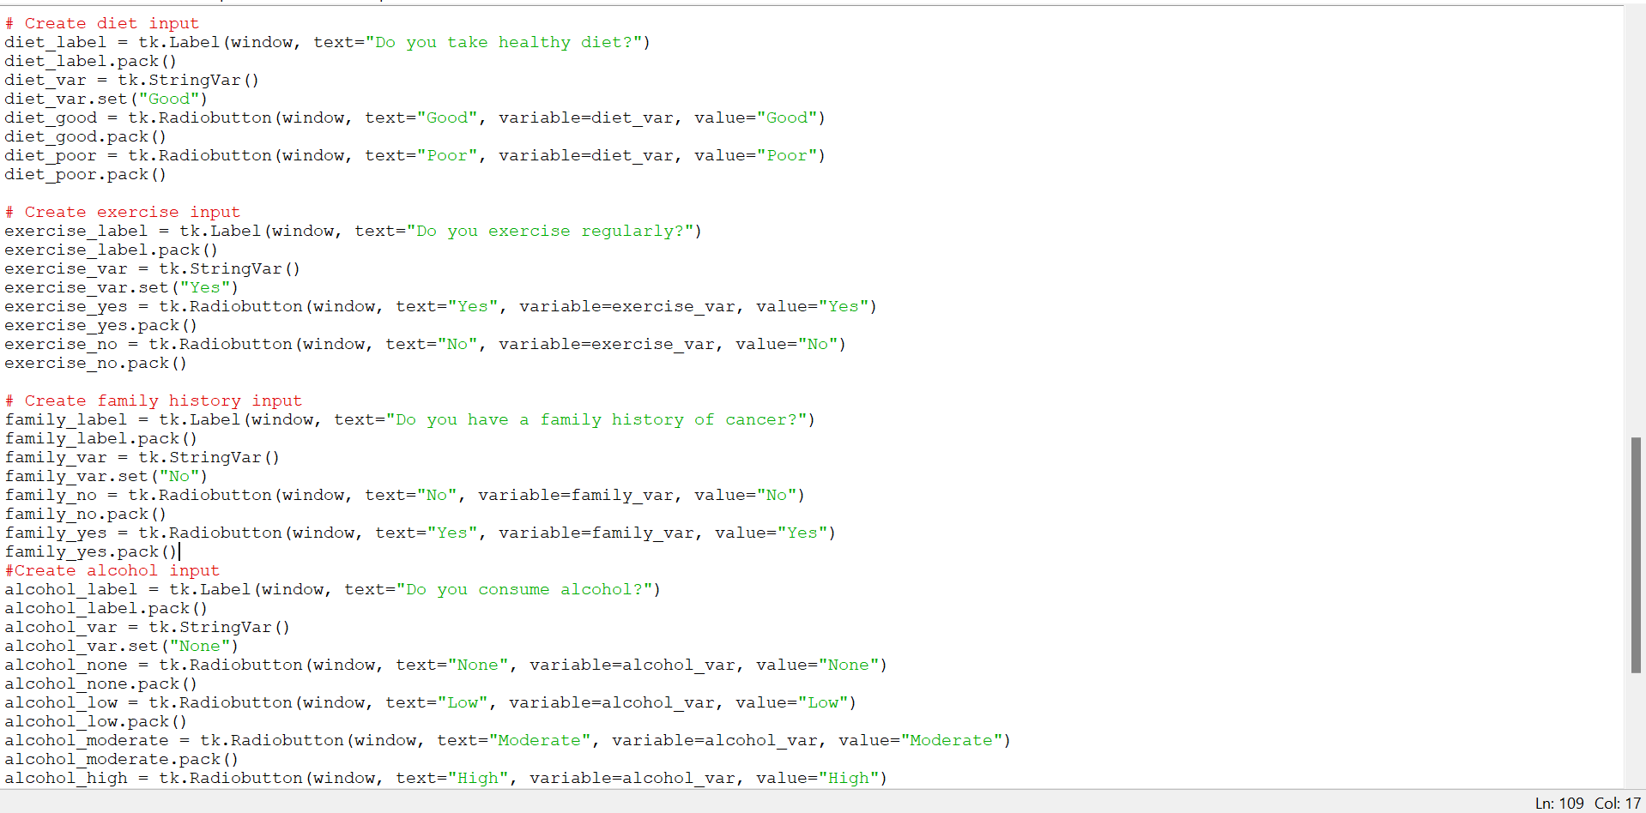
Python Code

Slide 8
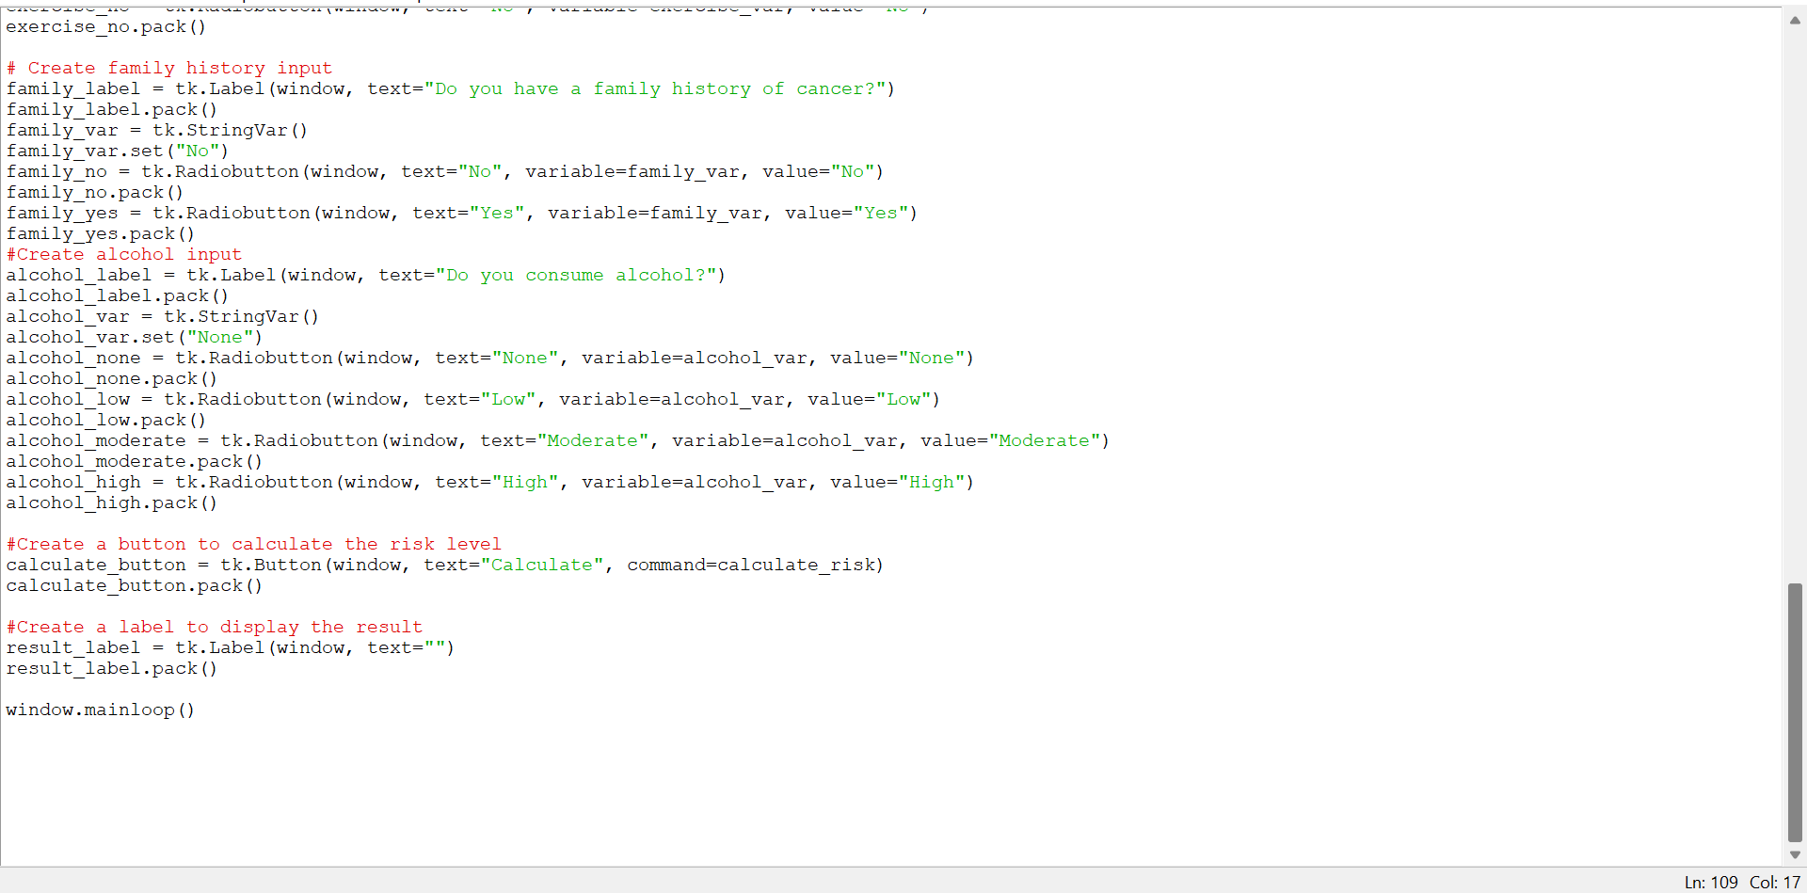
Python Code

Slide 9
FINAL OUTPUT

Slide 10

Thank You
Kusuma Korada
kkorada@mtu.edu

